Slide 1




2026 Energy Innovation Hackathon
From smart-meter data to battery programs
Classifying appliances, segmenting 33,927 homes and sizing behind-the-meter batteries from one year of hourly AMI
Team 08 · MIT Climate Hackers | Conor Mcmanamy, Charlotte Adriaenssens, Charles Loriot

Slide 2
Electrified homes drive peak load; target batteries
EXECUTIVE SUMMARY
Based on hourly meter data about 33,927 Avangrid homes
What we found
What we recommend
Hourly data is enough to read appliances. Physics signatures find EV chargers, the heating type, AC, solar and pools in every home, and far more chargers than the label list shows.
A small electrified group drives the winter peak. Homes heated with electricity are a sixth of customers but a third of the winter peak.
The winter peak is coming. If about one home in five adds a heat pump, the system peaks in winter, with long cold snaps that drain batteries.
Batteries pay off only when targeted. Grid value alone does not cover a battery; grid value plus customer bill savings roughly doubles it in the top tier.
Battery + managed EV charging for electrified homes (EV and electric heat): the most peak relief per home.
Batteries with heat-pump conversion in electric-heat homes: the largest pool of top-tier battery homes.
Charge from the sun where possible: solar homes can refill batteries at midday in summer; coordinate grid recharge in winter.
Coordinate fleet recharge before heat pumps scale, or overnight recharge sets a new night peak.
Use the dashboard to pick which segments to enrol and which homes to call first, and re-score as new meter data arrives.

Slide 3
The numbers behind the story
EXECUTIVE SUMMARY
Key results from the full analysis; each is explained on the slides that follow
2,582
16% → 34%
2.7% → 9%
≈20%
homes charge an EV at home: 3.5x what the labels imply
electric-heat segment: share of homes → share of the winter peak (19% of homes have some electric heat)
EV + electric-heat homes (927): share of homes → winter peak; 768 are top-30% battery homes
of homes with heat pumps makes the system peak in winter if they replace furnaces (36% if furnaces stay as backup)
2,263
$335 + $324
1.26 kW
53%
Tier 1 battery homes (top 10% of candidates): 3.4 MW summer / 2.6 MW winter peak relief
per Tier 1 (top-10%) home a year: avoided grid cost + customer bill savings (placeholder rates)
peak relief per EV home from managed charging alone, no battery: as much as a battery gives
of summer event days, solar homes could fill a battery from the sun first

Slide 4
Hourly reads, one weather station, partial labels
THE CHALLENGE
Three questions from the brief, answered from the data Avangrid provided
35,725 → 34,238
8,760
186 · 88 · 397
1 Classify appliances
EV (L1 / L2), heat pump vs resistive heat, AC, PV, pool, water heater, hot tub
meters in the brief → with reads in the AMI files (1,487 IDs have no data)
hourly readings each (Sep 2025 - Aug 2026)
EV · heat-pump · PV labels present
2 Segment customers
0 negatives
311 → 33,927
23
load behaviour, what drives it, who drives the summer and winter peaks
3 Size batteries and flexibility
delivered-only meters: PV exports clipped to 0
excluded (229 stuck, 81 short, 1 error) → homes modeled
very-high-load accounts reviewed and kept
candidates, sizing, value as avoided buildout cost; today and in a winter-peaking future
Context data: one hourly weather series (temperature, humidity, wind). No geography, tariff or demographics, so 'what drives what' means weather → load, appliance → load shape, segment → system peak.

Slide 5
One reproducible pipeline from raw reads to programs
OUR APPROACH
Six stages from raw meter reads to programs; each stage is checked before the next is built
1
2
3
4
5
6
Clean & check
Physics features
Classify
Segment & drivers
Batteries & DR
Future & playbook
stuck meters, spikes, high-load review, metering type
53 explainable features per home: weather slopes, events, shape
physics gates + PU ranking; heat pump vs resistive by response shape
rule segments, load-shape clusters and parts, peak shares
hour-by-hour SOC dispatch, sizing, avoided buildout, tiers
heat-pump scenarios, 3 kVA lens, segment cards, app
Physics first
Labels only check
Honest kWh
thresholds come from equipment ratings or natural gaps in a score, never from the labels
labels and a federal household survey (EIA RECS) are checks that are allowed to fail
batteries claim only the kW they can hold through the whole event window

Slide 6
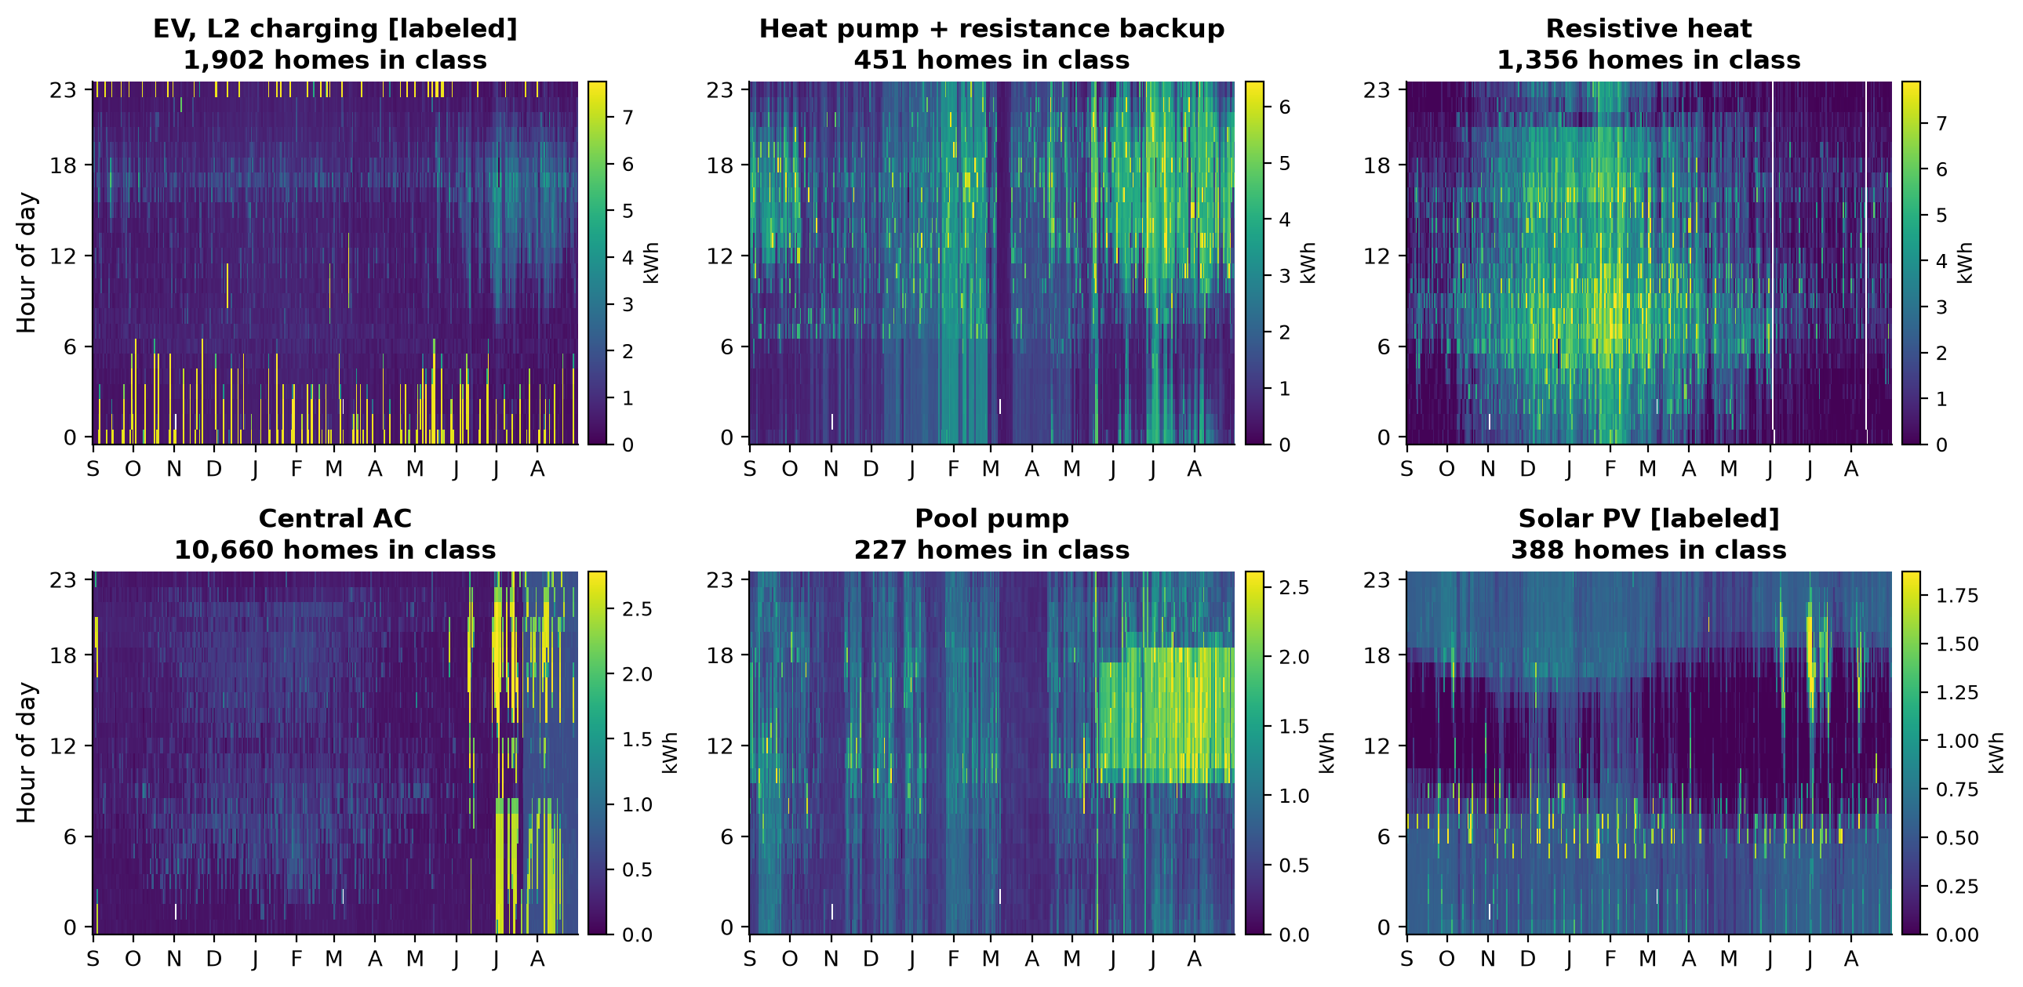
Physics signatures reveal appliances in hourly data
APPLIANCE CLASSIFICATION
One typical home per class (the medoid on the class's defining features): every hour of the year, Sep 2025 to Aug 2026
2,582
EV home charging (1,902 L2, 680 L1)
6,584
electric space heat: 19% of homes (1,560 heat pump)
13,404
central AC
388 · 227
solar PV · pool pumps

Slide 7
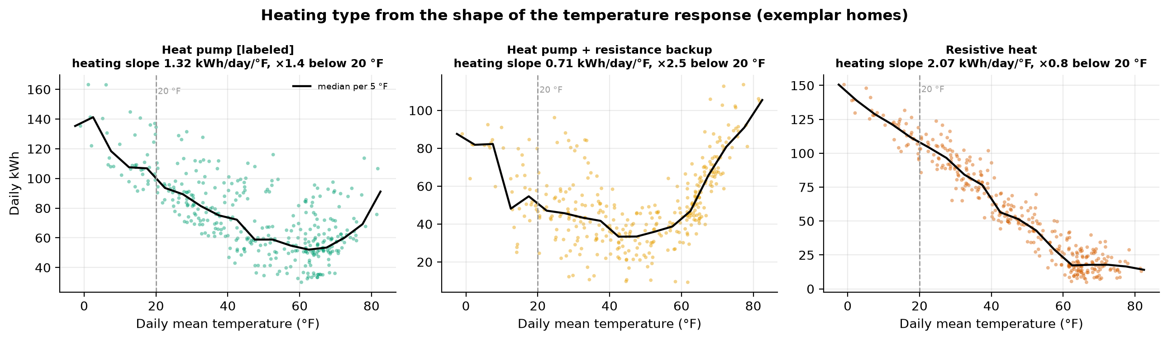
The cold-weather response reveals the heating type
APPLIANCE CLASSIFICATION
Daily kWh vs temperature for three typical homes: the slope below 20 °F tells the technologies apart
1,109
451
1,356
3,668
heat pump: moderate slope, mild steepening
heat pump + backup: slope ≥ 2× below 20 °F
resistive: steep, linear (COP = 1)
electric, type unclear at hourly resolution

Slide 8
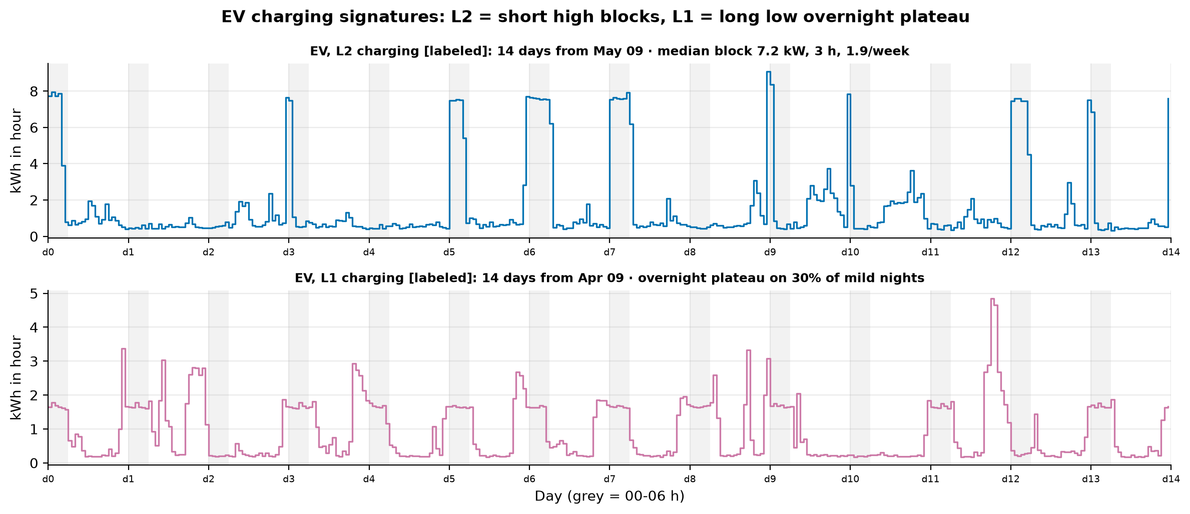
L2 and L1 charging leave different fingerprints
APPLIANCE CLASSIFICATION
Two weeks of a typical labeled L2 home and a typical labeled L1 home
1,902
L2 detectable: short high blocks ≥ 1 week in 4
680
L1 detectable: long low overnight plateau
36%
of labeled EV homes show home charging: many charge away from home or bought mid-year

Slide 9
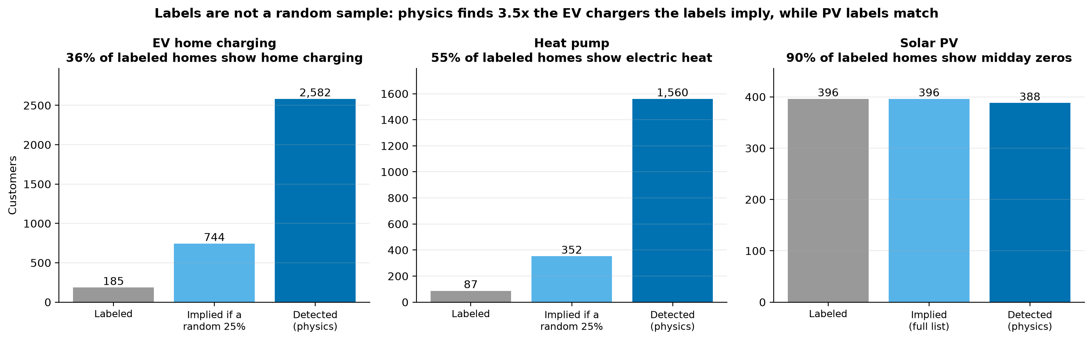
The labels are not a random sample, so physics leads
KEY FINDING
Physics finds 3.5x the EV chargers the labels imply; PV labels match the meter signature
The data imply only 3.5% of EV and 1.1% of HP owners are labeled, not 25%: labels only rank
EV ranking model, labeled vs unlabeled homes: AUC 0.78 (benchmark 0.74)
PV rule: 92% precision, 90% recall, 31 unregistered systems

Slide 10
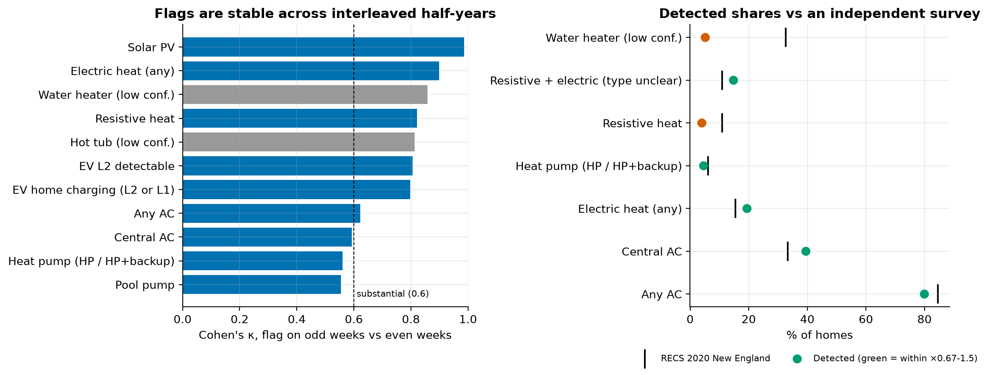
Flags are stable, seasonal and plausible
RIGOR
37 validation checks: 22 pass, 9 informational, 6 fail (3 designed to fail if labels were random, 3 survey gaps)
0.80
agreement of flags from odd vs even weeks (Cohen's κ, 1 = identical)
9/9
seasonal checks: heating fires in winter, cooling in summer
0.761
EV ranking accuracy (AUC) on held-out homes and weeks
0
battery power / SOC / export violations
Survey = EIA's Residential Energy Consumption Survey (RECS 2020), the U.S. government's survey of which appliances homes have. We compare with its New England sample: electric heat 19.4% vs 15.5% (×1.25), any AC 80.0% vs 84.5% (×0.95) (ours vs survey).

Slide 11
How sure we are, appliance by appliance
RIGOR
Homes flagged, how each appliance is detected, our confidence, and stability between two halves of the year
Appliance | Homes | Share | Detected by | Confidence | Stability κ | Check against labels / survey
EV home charging | 2,582 | 7.6% | charging blocks / overnight plateau | medium-high | 0.80 | 36% of labeled EV homes flagged
Electric space heat | 6,584 | 19.4% | cold-weather slope | high | 0.90 | 55% of labeled HP homes flagged
Heat pump | 1,560 | 4.6% | shape of the cold response | medium | 0.56 | 25% of labeled HP homes
Central AC | 13,404 | 39.5% | hot-weather slope | high | 0.59 | any AC close to the survey
Solar PV | 388 | 1.1% | midday zeros that follow the sun | high | 0.99 | 90% recall
Pool pump | 227 | 0.7% | summer timer band | medium | 0.55 | no labels or survey
Water heater | 1,753 | 5.2% | short bursts (blurred hourly) | low | 0.86 | well below the survey
Hot tub | 1,077 | 3.2% | cycling (blurred hourly) | low | 0.81 | no labels or survey
Stability κ = agreement between flags from odd and even weeks (1 = the same homes). Heat pump vs resistive and pool pumps are least stable (few deep-cold hours, short pool season); water heater and hot tub are stable but blurred by hourly data, so we do not act on them.

Slide 12
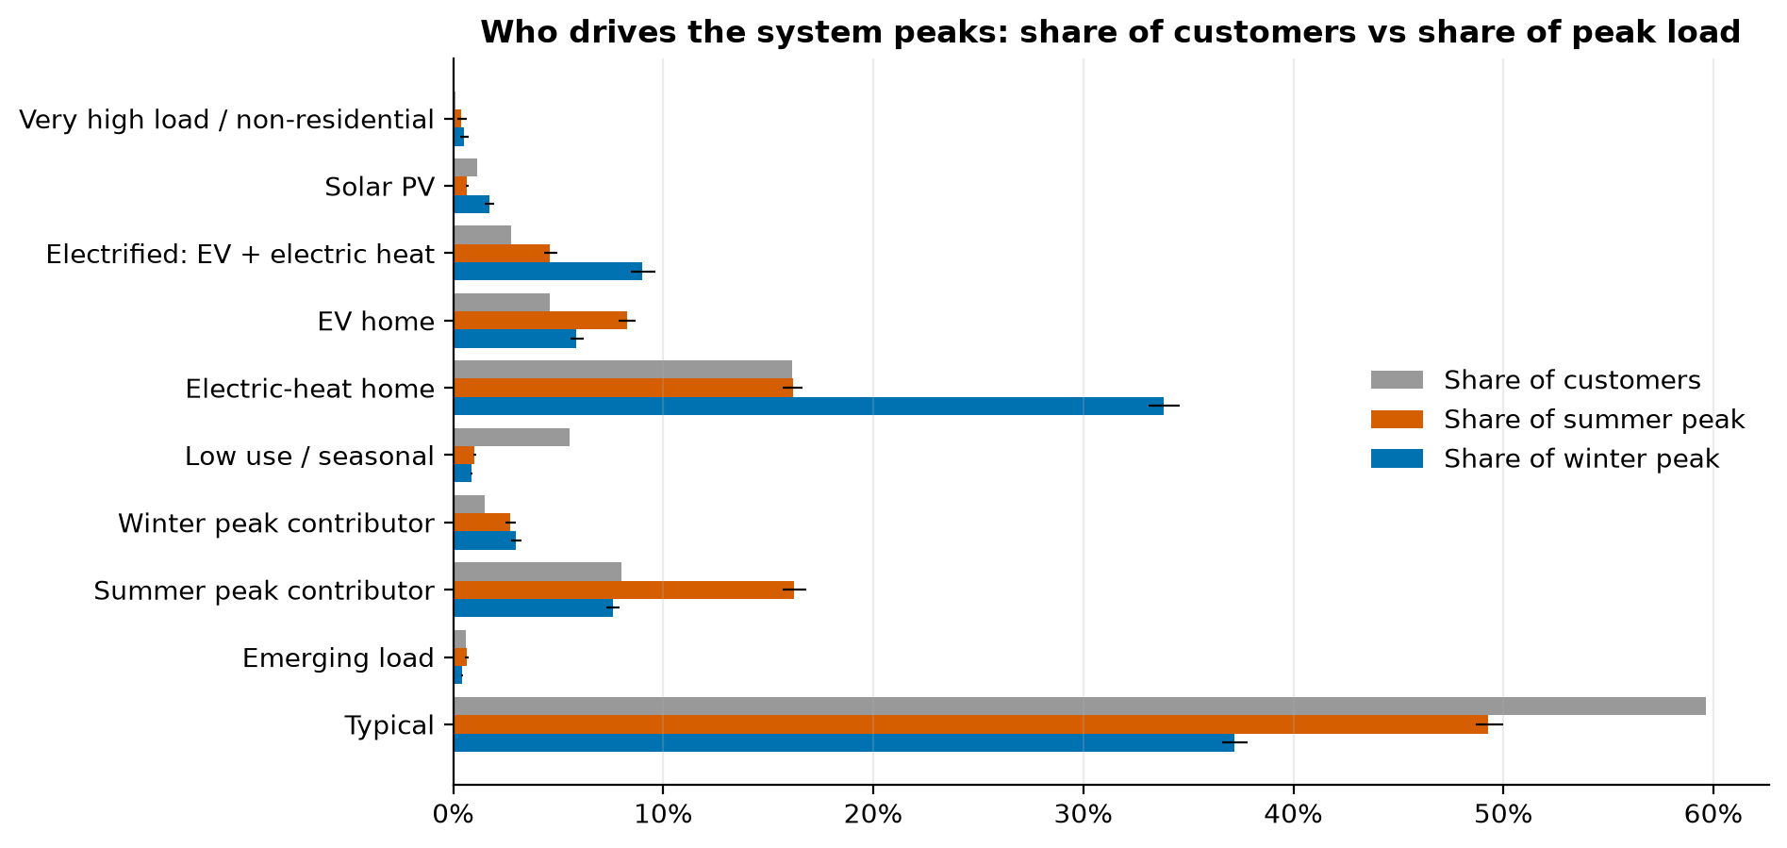
16% of homes carry 34% of the winter peak
SEGMENTATION
Share of customers vs share of the coincident summer and winter peak, by business segment (bars = 95% bootstrap CI)
16% → 34%
electric-heat segment: homes → winter peak (19% have electric heat; those that also charge an EV form the Electrified segment)
8% → 16%
summer peak contributors (98% central AC) → summer peak
60% → 49%
typical homes → summer peak (37% of winter)

Slide 13
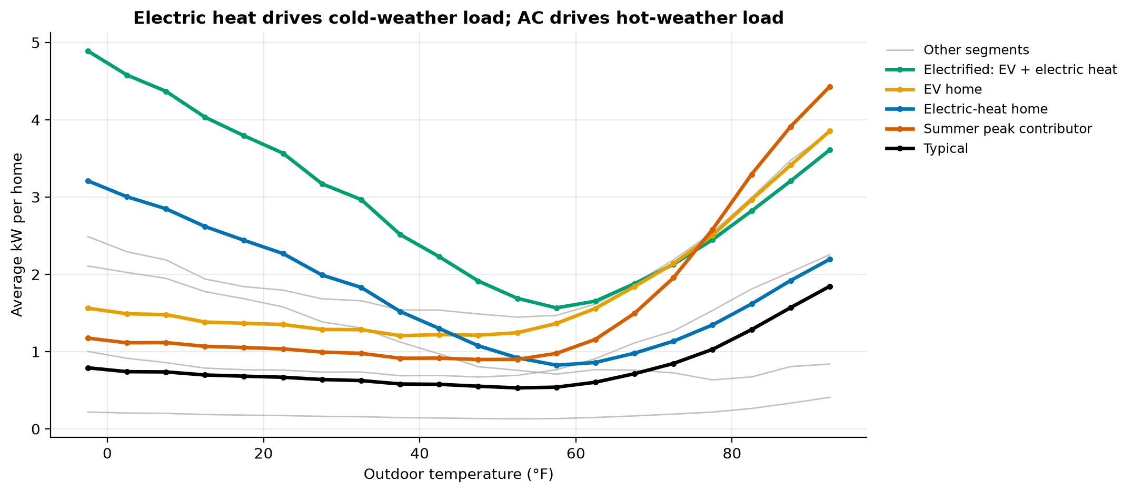
Cold drives electric-heat homes; heat drives AC homes
WHAT DRIVES LOAD
Average kW per home by outdoor temperature (left) and per appliance during the system peak hours (right)
kW per home at the system peak
5.6 kW
Resistive heat, winter peak
3.6 kW
Heat pump, winter peak
3.9 kW
Pool pump, summer peak
3.4 kW
EV, summer peak
Weather → load is causal (weather is exogenous). Appliance → peak is an association: e.g. resistive-heat homes average 5.6 kW at the winter peak.

Slide 14
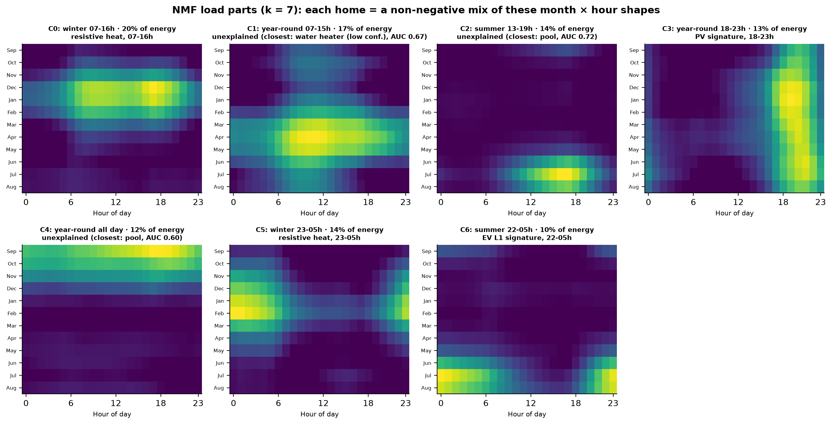
Each home mixes 7 load parts, found without labels
INNOVATION
A pattern-finding method (non-negative matrix factorisation, NMF) splits each home's yearly load shape into parts, before any labels
7 parts
the most parts that reappear in both halves of the year (with 8, one part appears in one half only)
55% vs 27%
winter heating parts: share of energy, electric-heat vs typical homes
AUC 0.58
match of the best part to L2 charging: too weak, so keep the event detector
The evening 'PV' part is a metering artefact: clipped midday load shifts PV homes' measured energy to the evening.

Slide 15
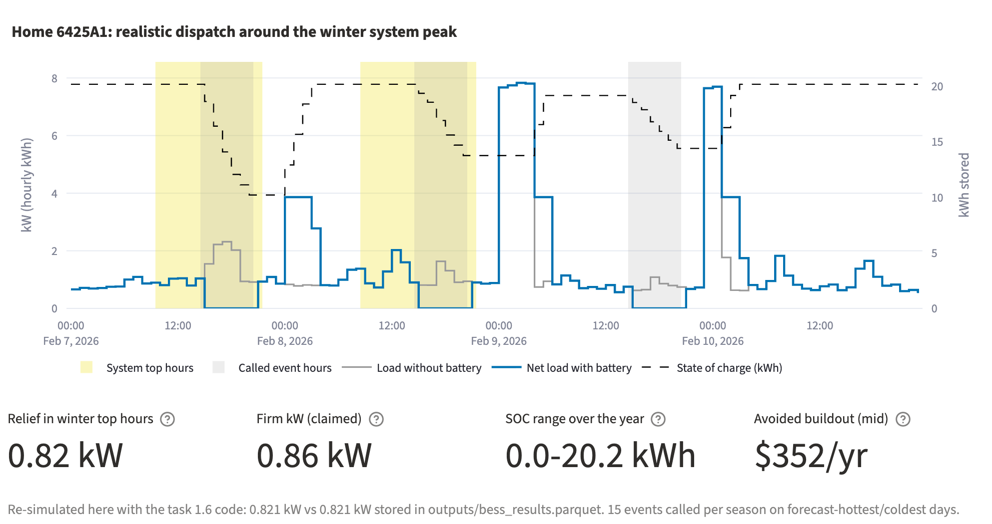
Batteries run hour by hour within their energy limit
BATTERY METHOD
2 × Enphase IQ 10C (20.16 kWh, 7.68 kW, 89.4% round trip), simulated over the full year for 22,682 candidate homes
Flat discharge ≤ 7.68 kW across the event window, never more than the home's load (no export)
Overnight recharge 00-05 h only, never above the home's own p95 load (no new peak)
Multi-day events: state of charge carries across back-to-back hot or cold days
Realistic calls: 15 events per season on forecast hottest / coldest days
Claim firm kW, not nameplate: the level held through the whole window
Realistic dispatch delivers 67% (summer) / 58% (winter) of perfect-foresight relief

Slide 16
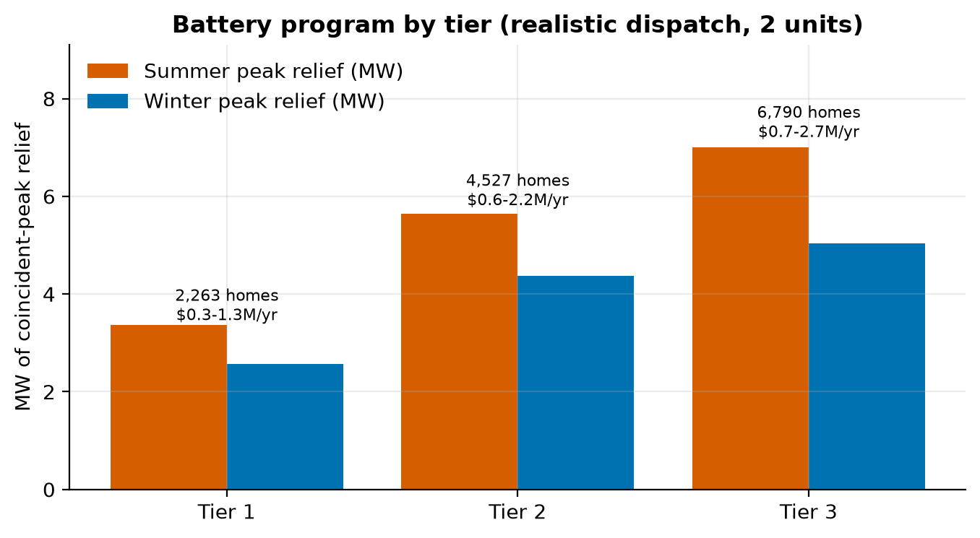
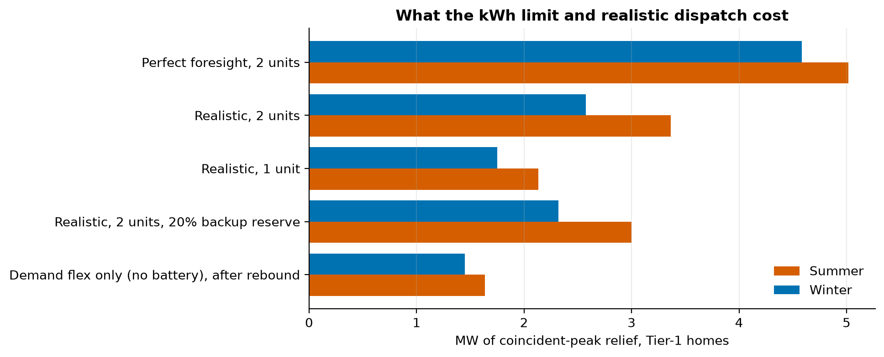
2,263 Tier 1 homes cut 3.4 MW summer, 2.6 MW winter
BATTERY RESULTS
Candidates ranked by a score rewarding avoided buildout, peak persistence, battery coverage, EV / electric heat and solar
33,927 homes modeled
22,682 battery candidates
2,263 Tier 1 = top 10%
4,527 Tier 2 = next 20%
6,790 Tier 3 = next 30%
1,383
844
36
1.49 / 1.14 kW
Tier 1 homes: 2 units cover their peaks
need 2 units plus demand flex
fully covered by 1 unit
relief per Tier 1 home (summer / winter)

Slide 17
Avoided buildout alone does not pay for a battery
BUSINESS VALUE
Bill savings roughly double the value per Tier 1 (top-10%) home: $335 grid + $324 bill a year
$335/yr
Avoided-cost assumptions ($/kW-yr, placeholders pending Avangrid's values)
avoided buildout per Tier 1 home (mid)
Component | Low | Mid | High | Applied to
Capacity | 30 | 60 | 100 | relief at the annual system peak
Transmission | 50 | 100 | 150 | mean of summer and winter relief
Distribution deferral | 25 | 75 | 150 | max of summer and winter relief
$324/yr
bill savings per Tier 1 home: battery shifts on-peak use (placeholder TOU)
Constrained feeders
Electrification headroom
Customer value
$3,051
distribution deferral is local: place batteries where an upgrade is deferred
keep heat-pump and EV adopters inside 3 kVA without a service upgrade
bill savings at a TOU rate of $0.32 on-peak (14-19 h weekdays) vs $0.18, plus backup power
grid NPV per Tier 1 home, 15 years at 7%
$0.3-1.3M
grid value per year, all Tier 1 homes (low-high)

Slide 18
Without a battery, managed EV charging matches one
DEMAND FLEXIBILITY
Peak relief per home from demand response alone (realistic events, rebound included) vs a two-unit battery in the same homes
Program (no battery) | Season | Homes | Relief per home | Total relief | Battery per home
Managed EV charging | summer | 2,492 | 1.26 kW | 3.1 MW | 1.23 kW
Managed EV charging | winter | 2,492 | 1.02 kW | 2.5 MW | 1.07 kW
AC thermostat | summer | 10,900 | 0.16 kW | 1.8 MW | 1.07 kW
Heat thermostat | winter | 5,343 | 0.21 kW | 1.1 MW | 0.77 kW
0.72 vs 1.49 kW
Tier 1 (top 10%) homes, summer: demand response vs battery per home
0.64 vs 1.14 kW
Tier 1 homes, winter: demand response vs battery per home
Managed EV charging gives about a battery's worth of peak relief at almost no hardware cost. Thermostat programs give little per home after the rebound, but reach many homes: worth running as a low-cost first step.
1.6 MW
summer DR relief across all Tier 1 homes, before any battery

Slide 19
Solar homes can fill batteries from the sun in summer
SOLAR + BATTERY
The meters record 0 when solar covers the whole home, so midday zero hours mark solar energy free to charge a battery
388
2.9 vs 0.6 h
53% vs 5%
2.40 vs 1.15
solar homes detected; 5 already show a battery
midday hours a day at zero, summer vs winter (solar surplus)
summer vs winter event days with 3+ midday hours of surplus before the call
kW per solar home at the winter vs summer system peak
Summer: charge from the sun
Winter: the grid must refill
Program: PV + storage
On about half of summer event days a solar home's battery can refill at midday, so it needs no overnight grid recharge and adds no night load.
Solar barely covers winter middays, and solar homes peak on winter evenings (2.40 kW at the system peak), so winter recharge must be coordinated like any other battery.
91 solar homes are in the top 30% of battery candidates (34 in the top 10%). Offer storage to solar owners first: the battery also stores their own surplus instead of exporting it.

Slide 20
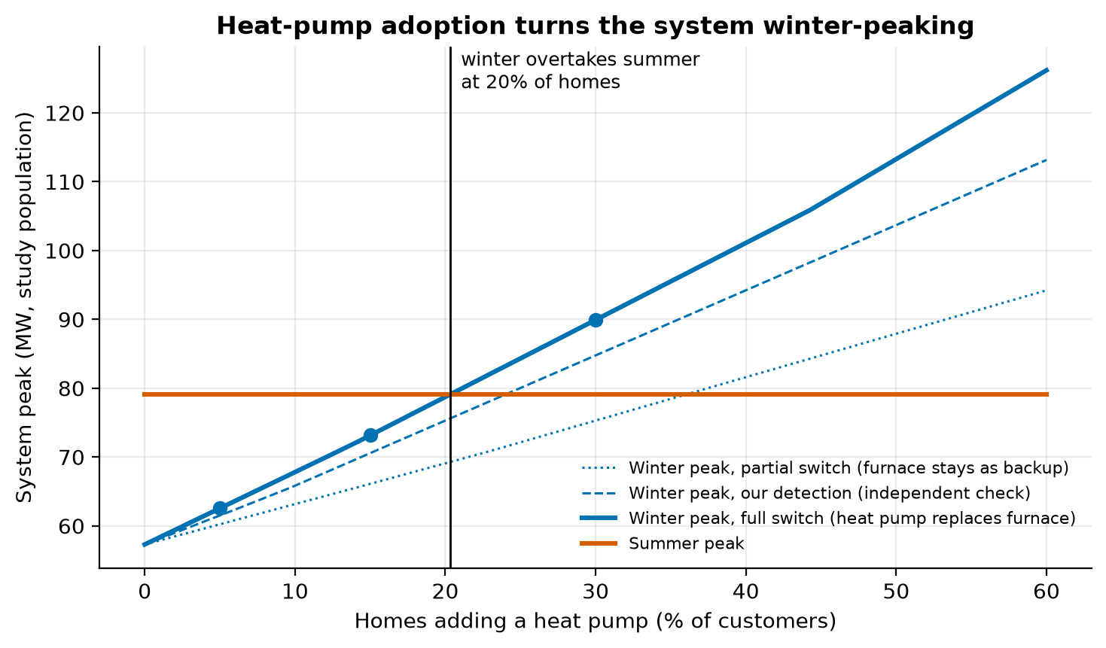
Winter overtakes summer at 20%-36% heat-pump adoption
FORWARD LOOK
System peak vs share of homes adding a heat pump: 20% if heat pumps fully replace furnaces, 36% if furnaces stay as backup
72%
today's winter peak vs summer (57.3 vs 79.1 MW)
20%
winter overtakes summer if heat pumps replace furnaces (24% by our detection, 36% if furnaces stay)
89.9 MW
winter peak at 30% adoption (summer 79.1 MW)
+2.9 kW
per adopting home at the winter peak

Slide 21
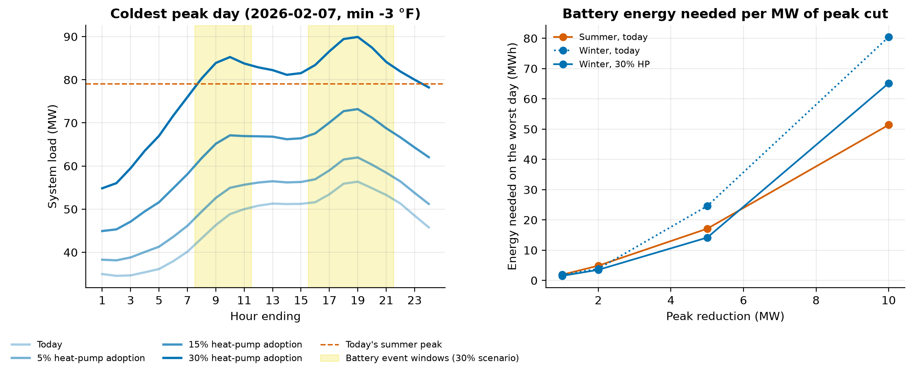
A winter peak demands coordinated battery recharge
FORWARD LOOK
The coldest peak day under each adoption scenario (left) and the battery energy needed per MW of peak cut (right)
108 MW
89.9 → 84.0 MW
0.85 kW
night peak if batteries recharge uncoordinated (30% adoption)
annual peak with coordinated fleet recharge
winter relief per adopter home, coordinated

Slide 22
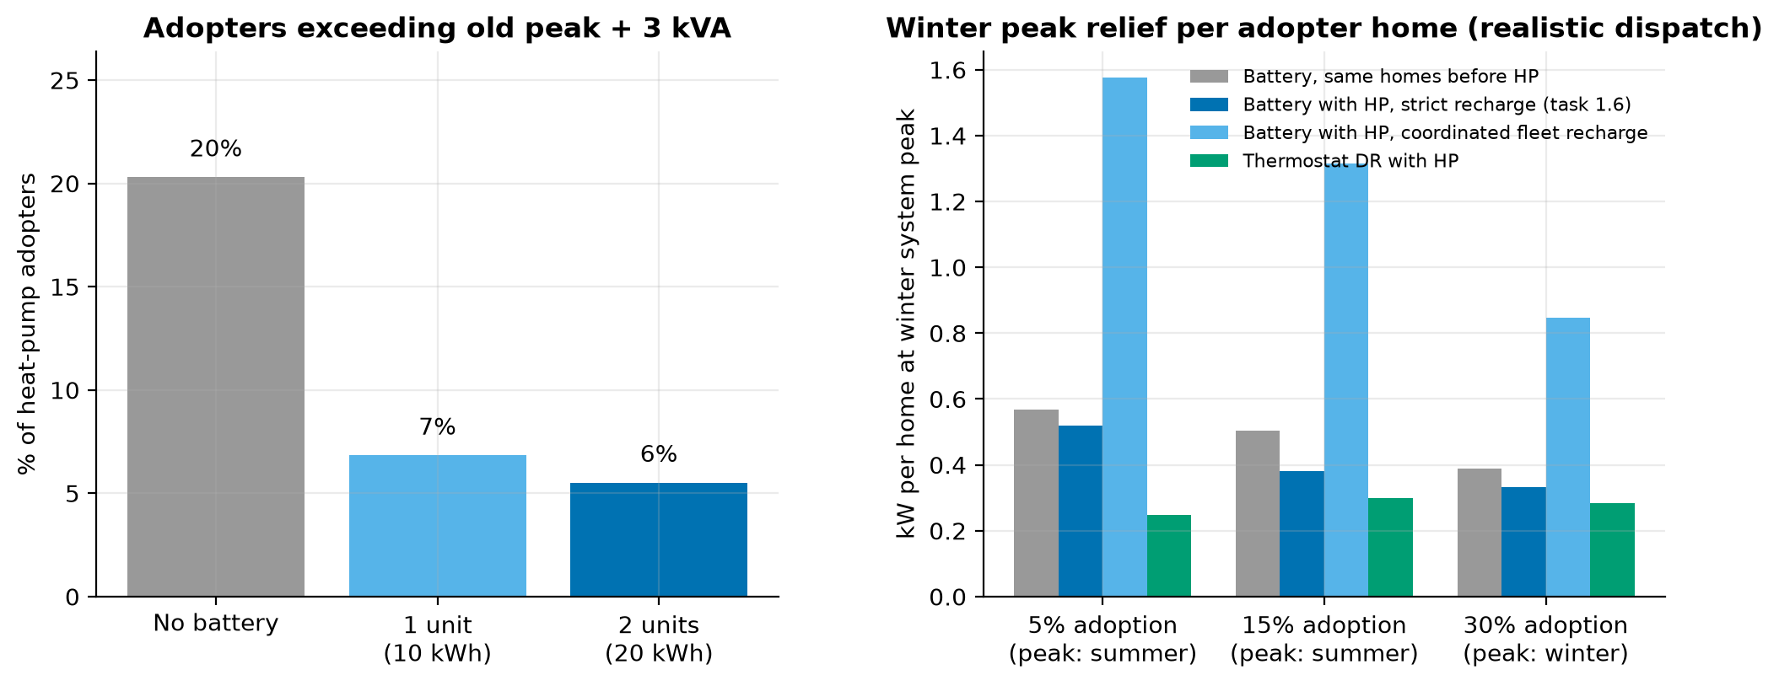
Batteries keep most overloaded adopters within 3 kVA
ELECTRIFICATION ENABLEMENT
Heat-pump adopters exceeding their old peak + 3 kVA, without and with a battery (left); winter relief per adopter (right)
20%
66%
73%
of adopters exceed old peak + 3 kVA (median 12 h/yr)
of those brought within the cap by 1 unit
brought within the cap by 2 units

Slide 23
A program for every segment, sized in homes and MW
PROGRAM PLAYBOOK
Now = launch with today's data · Next = after a pilot or confirmed avoided-cost values · Watch = monitor, no offer yet
When | Segment | Program | Target (top-30% / top-10% battery homes) | MW from top-30% homes, summer / winter
Now | Electrified: EV + electric heat | Battery + managed EV charging + heat DR bundle | 768 top-30% homes | 1.12 / 0.96
Now | Electric-heat home | Batteries for top-10%; resistive → heat-pump conversion; weatherisation | 2,717 top-30% homes | 3.43 / 2.53
Now | EV home | Managed charging / EV TOU; batteries for top-10% | 1,563 homes (515 top-10%) | 1.49 / 1.20
Next | Summer peak contributor | AC thermostat DR (mass); batteries on summer-constrained feeders | 763 next-20% homes | 1.09 / 0.74
Next | Winter peak contributor | Batteries (year-round value); heat-pump-ready audits | 333 next-20% homes | 0.45 / 0.45
Next | Solar PV | PV + storage retrofit for winter evenings | 88 top-30% homes | 0.08 / 0.09
Next | Typical | TOU + behavioural DR; heat pumps sold with managed controls | 20,237 homes | 1.30 / 0.93
Watch | Emerging load | Transformer watch-list; EV / heat-pump readiness outreach | 202 homes | 0.01 / 0.01
Watch | Very high load / non-residential | Rate-class review; commercial storage / C&I DR | 28 accounts | 0.04 / 0.03
None | Low use / seasonal | No program (vacancy / meter-health only) | 1,885 homes | n/a

Slide 24
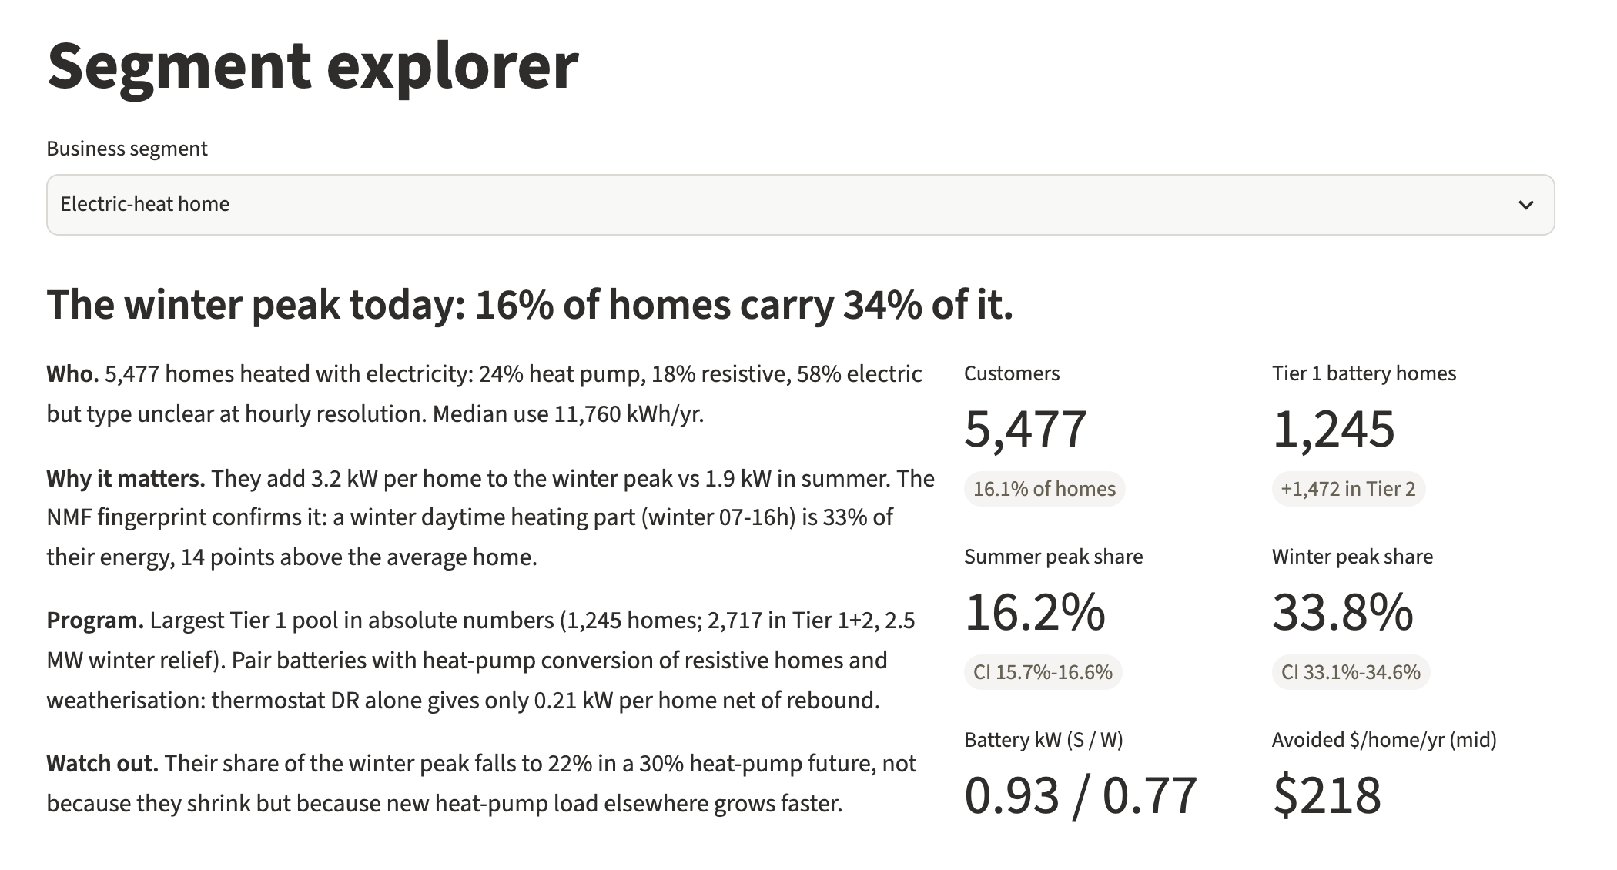
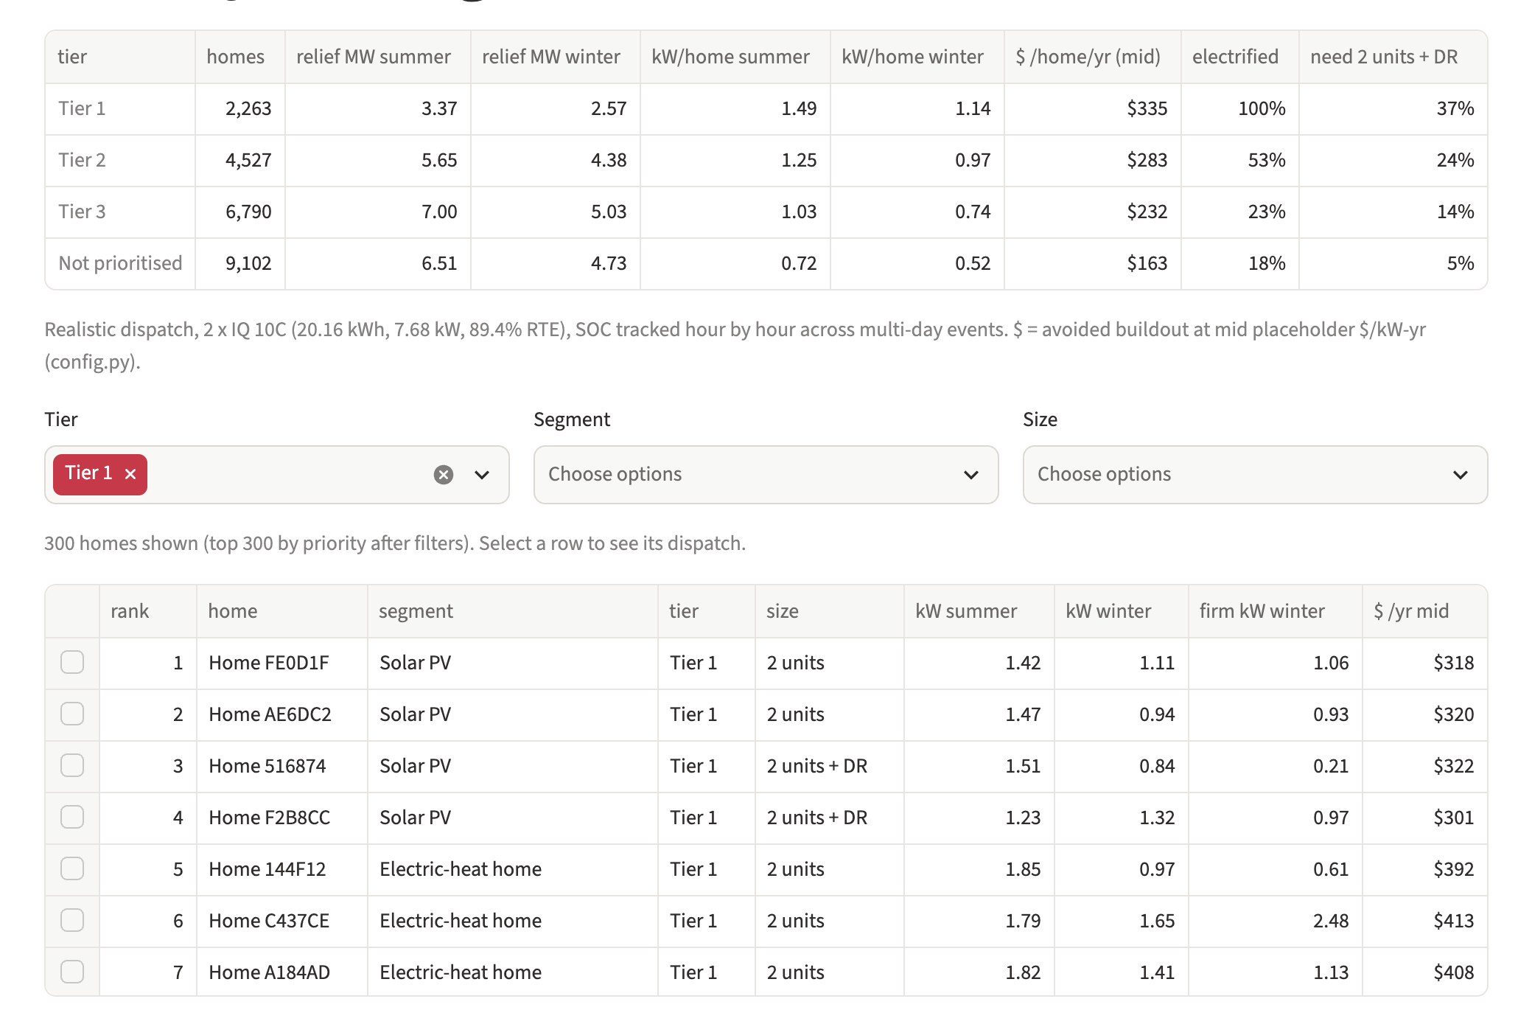
A dashboard to explore segments and pick targets
DASHBOARD
Runs from the repository on Avangrid's own machines (no data leaves them); we will demo it live · customer IDs anonymised
Segment explorer: size, peak share, battery tiers, program and load shape for each segment
Battery ranking: filter by tier, segment and size; open any home's evidence and dispatch
Decisions it supports: which segments to enrol, how many homes and MW each program reaches, and which homes to call first.

Slide 25
The method scales to millions of meters
SCALING
Every home is processed on its own, so the work splits across machines; runtimes measured on one laptop for 34,238 homes
15 min
Per-home steps run in parallel
Columnar storage, no big joins
Cleaning, features, appliance flags, weather response and battery dispatch use one home's data only: split customers into batches on any cluster.
Raw reads stream into Parquet and DuckDB; system peaks and segment shares need only per-home totals.
raw reads to every output for 34,238 homes on one laptop
≈7 h
per million homes on one laptop; minutes on a cluster
Fit once, score everywhere
Re-score as data arrives
The PU rankers, load-shape parts and archetypes are fitted on a sample and applied to every new home in seconds.
Monthly AMI updates re-score each home; homes that start charging an EV or add a heat pump move segment automatically.
35 GB
a year of hourly reads per million homes: streamed in chunks, never held in memory

Slide 26
What the data cannot tell us yet
LIMITATIONS
All limitations in one place, and what from Avangrid would remove each one
Data
Labels
Hourly reads blur water heaters, hot tubs and heat-pump cycling (low confidence, not used for programs)
Delivered-only meters hide solar exports and system size; one weather station; no feeder or location
Would fix it: sub-hourly or net-metered data; feeder / transformer IDs
Not a random sample: used to check and rank, not to set thresholds or estimate totals
Heat pump vs resistive is the least stable split between the two halves of the year
Would fix it: how the EV / heat-pump labels were collected
Economics
Modeling
Avoided-cost $/kW-yr and the TOU tariff are placeholders; distribution deferral is local, so system averages understate the best sites
Would fix it: Avangrid's avoided-cost values and tariffs
Demand-response shed and rebound are assumptions; the heat-pump future is built from few labeled homes; appliance → peak links are associations, not causes
Would fix it: pilot results to calibrate response and adoption
Every assumption is a parameter: new values from Avangrid rerun the whole analysis and this deck.

Slide 27
Thank you
Electrified homes drive the peak, and the winter peak is coming.
Target batteries where value stacks, pair them with managed charging and heat-pump programs, and coordinate the fleet before heat pumps scale.
https://github.com/charleslrt20/avangrid_hackathon

Slide 28
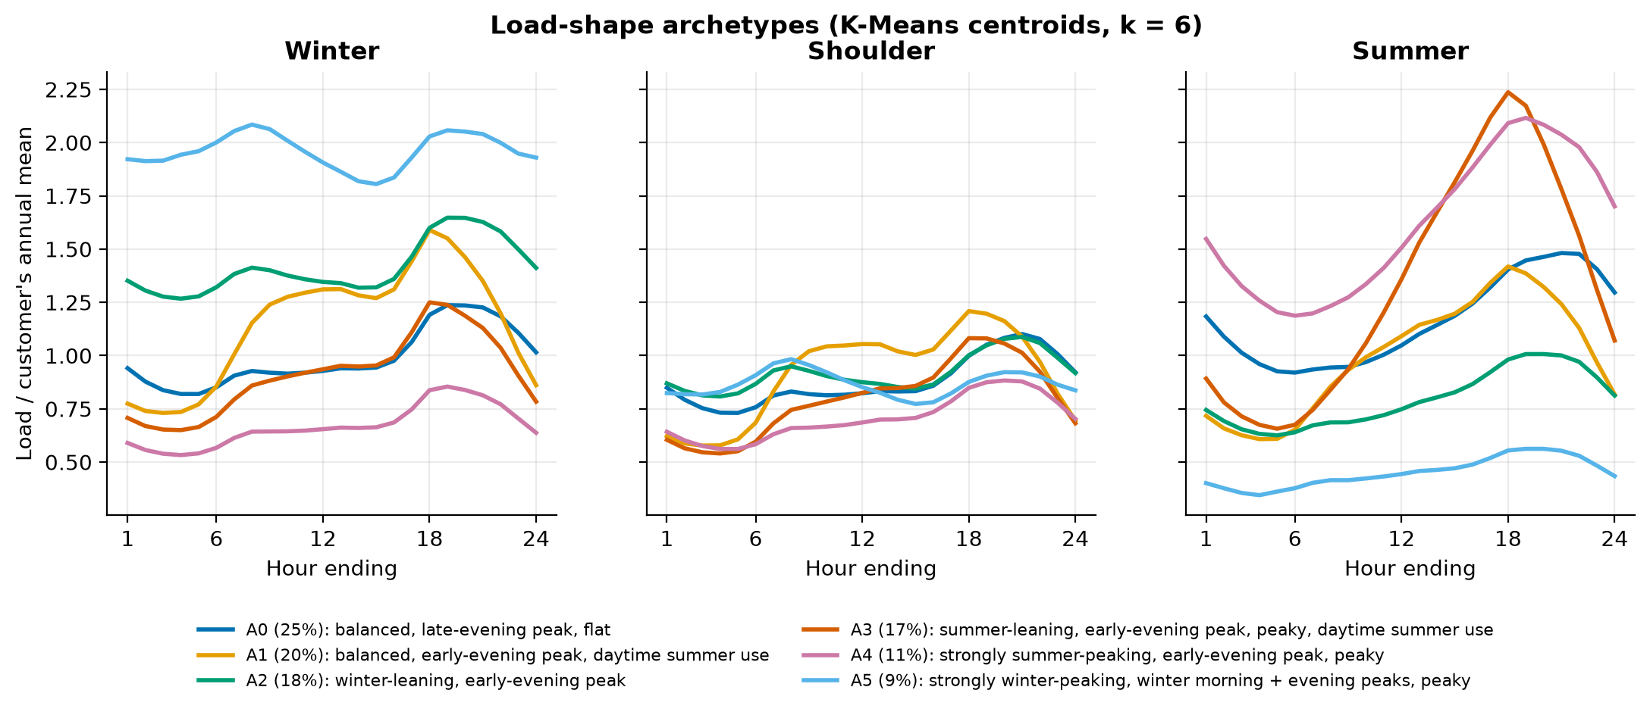
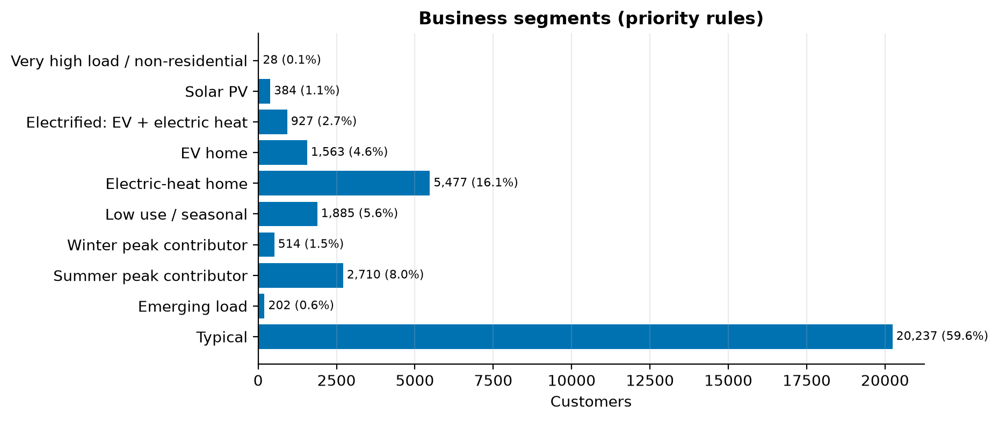
Segment sizes and load-shape archetypes
APPENDIX
Rule-based segments (left); K-Means archetypes on normalised seasonal shapes form a continuum (right)
K-Means silhouette / Davies-Bouldin = 0.133 / 1.86: archetypes on a continuum, not separable clusters, so the rule segments are primary.
Notes:
K-Means silhouette and Davies-Bouldin: 0.133 / 1.86. Shapes form a continuum, which is why we added NMF.

Slide 29
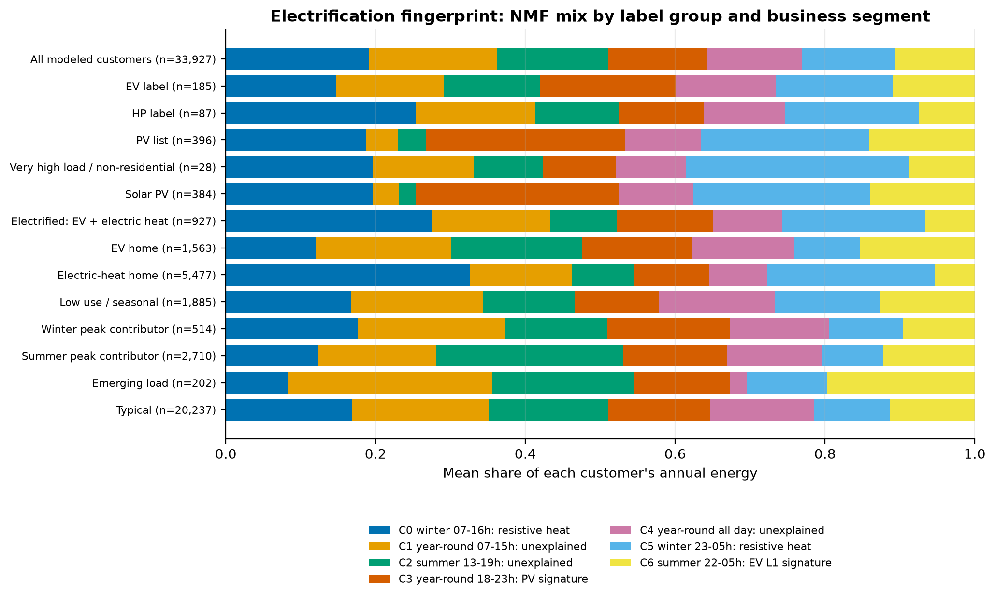
Electrification fingerprint by segment
APPENDIX
Mean share of each customer's annual energy explained by each NMF part
Notes:
Electric-heat homes: about 55% of energy in the winter heating parts. Emerging-load homes carry more year-round daytime and summer overnight load than typical homes.

Slide 30
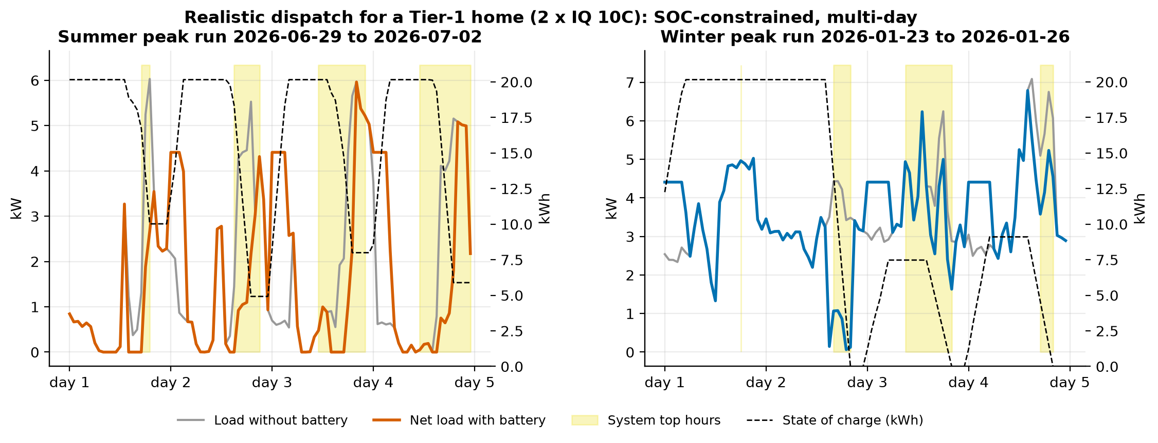
Battery dispatch for a top-10% home, summer and winter
APPENDIX
Static version of the app view: load, net load with battery, system top hours and state of charge across multi-day peak runs

Slide 31
The model in six equations
APPENDIX
Every flag, segment and battery number in the main deck comes from one of these
Weather response (per home, per day)
Positive-unlabeled ranking (Elkan-Noto)
kWh_{d} = β₀ + β_{h}·HDD_{d}(T_{h}) + β_{c}·CDD_{d}(T_{c}) + β_{x}·HDD_{d}(20°F) + β_{w}·HDD·wind + β_{e}·weekend
g(x) = P(labeled | x), P(owner | x) = g(x) / c, ĉ = mean g(x) over labeled
β_{x} > 0: slope steepens in deep cold (heat-pump backup); resistive heat stays linear
ĉ = 0.035 (EV), 0.011 (HP) vs 0.25 in the brief → labels not random: g used to rank only
Load decomposition (NMF)
Battery state of charge (hour by hour)
S_{i} ≈ Σ_{j} w_{ij} H_{j}, w_{ij} ≥ 0, Σ H_{j} = 1
SOC_{t+1} = SOC_{t} + η·c_{t} − d_{t}, 0 ≤ SOC ≤ E, d_{t} ≤ min(P, load_{t})
S_{i} = 12-month × 24-hour shape summing to 1, so w_{ij} = share of energy; k = 7 chosen without labels
E = 20.16 kWh, P = 7.68 kW, η = 89.4%; recharge 00-05 h only, never above the home's own p95 load
Avoided buildout ($/yr)
Battery priority score
V = p_{cap}·ΔkW_{peak} + p_{tx}·mean(ΔkW_{S}, ΔkW_{W}) + p_{dist}·max(ΔkW_{S}, ΔkW_{W})
score = 0.45·rank(V) + 0.15·persist. + 0.15·coverage + 0.15·electrified + 0.10·PV
mid $/kW-yr 60 / 100 / 75 (placeholders); NPV over 15 yr at 7%
Tier 1 / 2 / 3 = top 10% / next 20% / next 30% of 22,682 candidates
Notes:
Change-point regression per home; PU learning (Elkan-Noto) used as a ranking because estimated c is far from 0.25; NMF on normalised shapes; SOC-constrained dispatch; avoided cost; priority score.

Slide 32
Reproducibility: for the team and reviewers
APPENDIX
How every table, figure and number in this deck is rebuilt from the raw data
One command
Every assumption in one file
Numbers are audited
bash scripts/run_all.sh --from-raw
rebuilds data_processed/, outputs/, figures, segment cards and the per-customer results; bash deck/build.sh rebuilds this deck.
src/avangrid/config.py: battery spec, event budget, avoided-cost $/kW-yr low / mid / high, TOU tariff, thresholds from equipment ratings.
Every slide number comes from deck/facts.json, written from outputs/; an audit fails the build on any number it cannot trace.
Repository: pipeline, app, README with setup and run steps, requirements.txt · https://github.com/charleslrt20/avangrid_hackathon
Notes:
Number audit: scripts/12_number_audit.py fails the build if any number on a slide does not trace to deck/facts.json.

